Slide 1
JavaScript - UFO hunter game Pause position

Slide 2
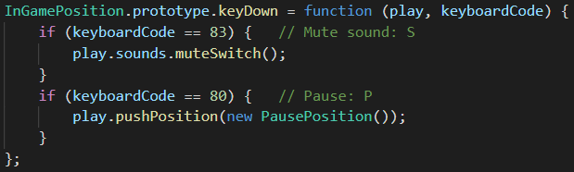
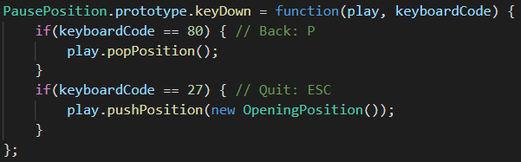
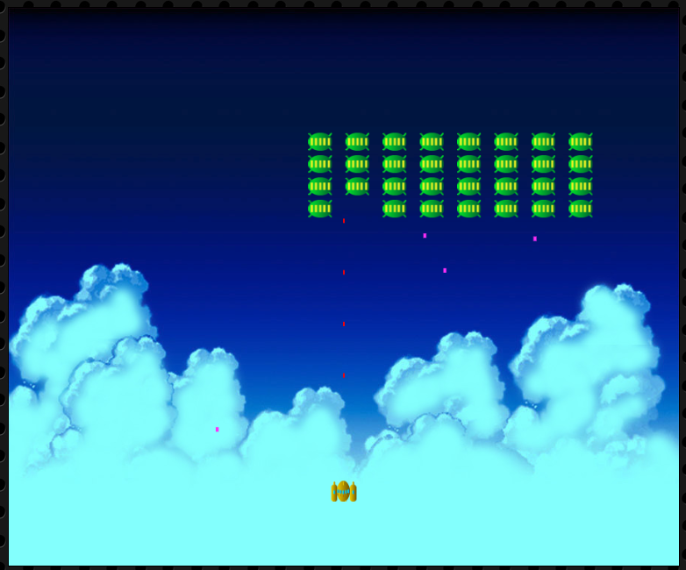

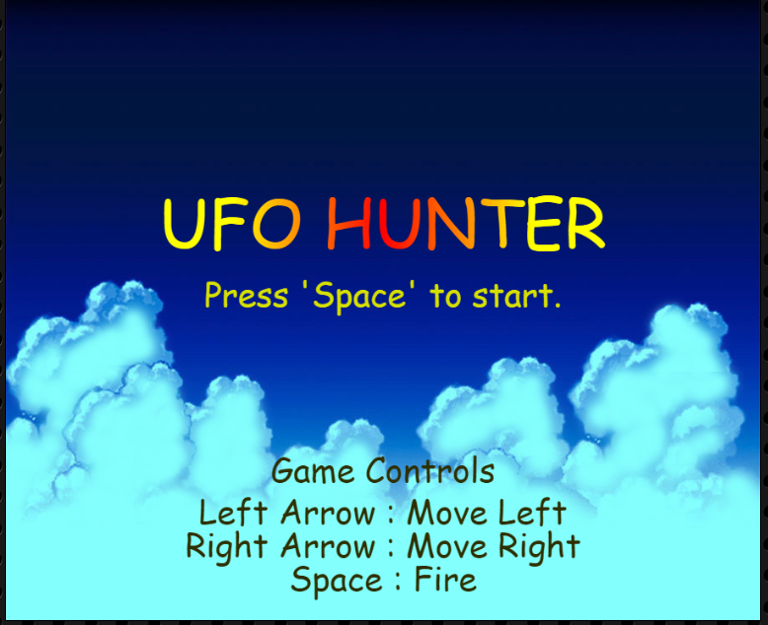
PausePostion
P
positionContainer
InGamePostion
positionContainer
PausePostion
InGamePostion
positionContainer
OpeningPostion
P
ESC

